Slide 1

AUTOMATED DETECTION AND GRADING OF DIABETIC RETINOPATHY

Slide 2
TEAM:
1.Nidhi Bartakke(1215316739)
2.Nikhitha Nimmagadda(1215316740)
3.U.Sri.Chandana(1215316757)
4.Krishna Sai(1215316717)
GUIDE:
Veerbhadra Rao

Slide 3
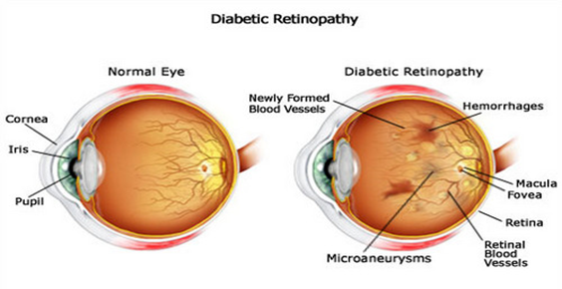
WHAT IS DIABETIC RETINOPATHY(DR)?
Diabetic retinopathy may be a medical condition during which damage is caused to retina. It's due to the damage to the blood vessels of the light-reactive tissue at the rear of the attention (retina).
High blood glucose in diabetic patients harm the walls of the tiny blood vessels within the eye, changing their construction and performance. These vessels might get thicker, ooze, form clots, close off, or build spheroid defects called microaneurysms.
As the condition advances symptoms include:
Marks or dark strings gliding in your vision
Dark or empty areas in your vision
Fluctuating vision
Blurred vision
Impaired color vision
Loss of vision

Slide 4
IDEA/ABSTRACT
Most prevalent cause affecting working age population in the world
Recent Research has given better understanding of requirements in clinical eye care practice.
Computer Aided disease diagnosis ease of mass screening of population and less time consuming..
There are comparatively less number of expert eye clinicians in this field as compared to the vast population having this disease,its a tool to avert vision impairement by detecting DR.
Grading of retinal imagesby clinicians:
  0 - No DR
  1 - Mild
  2 - Moderate
  3 - Severe
  4 - Proliferative DR

Slide 5
EXISTING SYSTEM
Manual Grading used
Expert and Experienced Eye specialist or Opthalmologists required in remote areas which is rare.
DR detection is challenging because by the time human readers submit their reviews, often a day or two later, the delayed results lead to lost follow up, miscommunication,and delayed treatment. Clinicians can identify DR by the presence of lesions associated with the vascular abnormalities caused by the disease.
Its resource demands are high.

Slide 6
PROPOSED SYSTEM
The current system diagnosing diabetic retinopathy has been based on explicit extraction of features like microaneurysms and lesions through which the classification is performed.
Using Computer Aided techniques like Deep learning algorithms
As the proposed method maintains a monotonic relationship with clinical DR grades, patient with higher scores can be prioritized for ophthalmologist evaluation against patients with lower scores.
The performance of the proposed system is evaluated or calculated by testing it on Drive database using parameter such as sensitivity, specificity and accuracy.

Slide 7
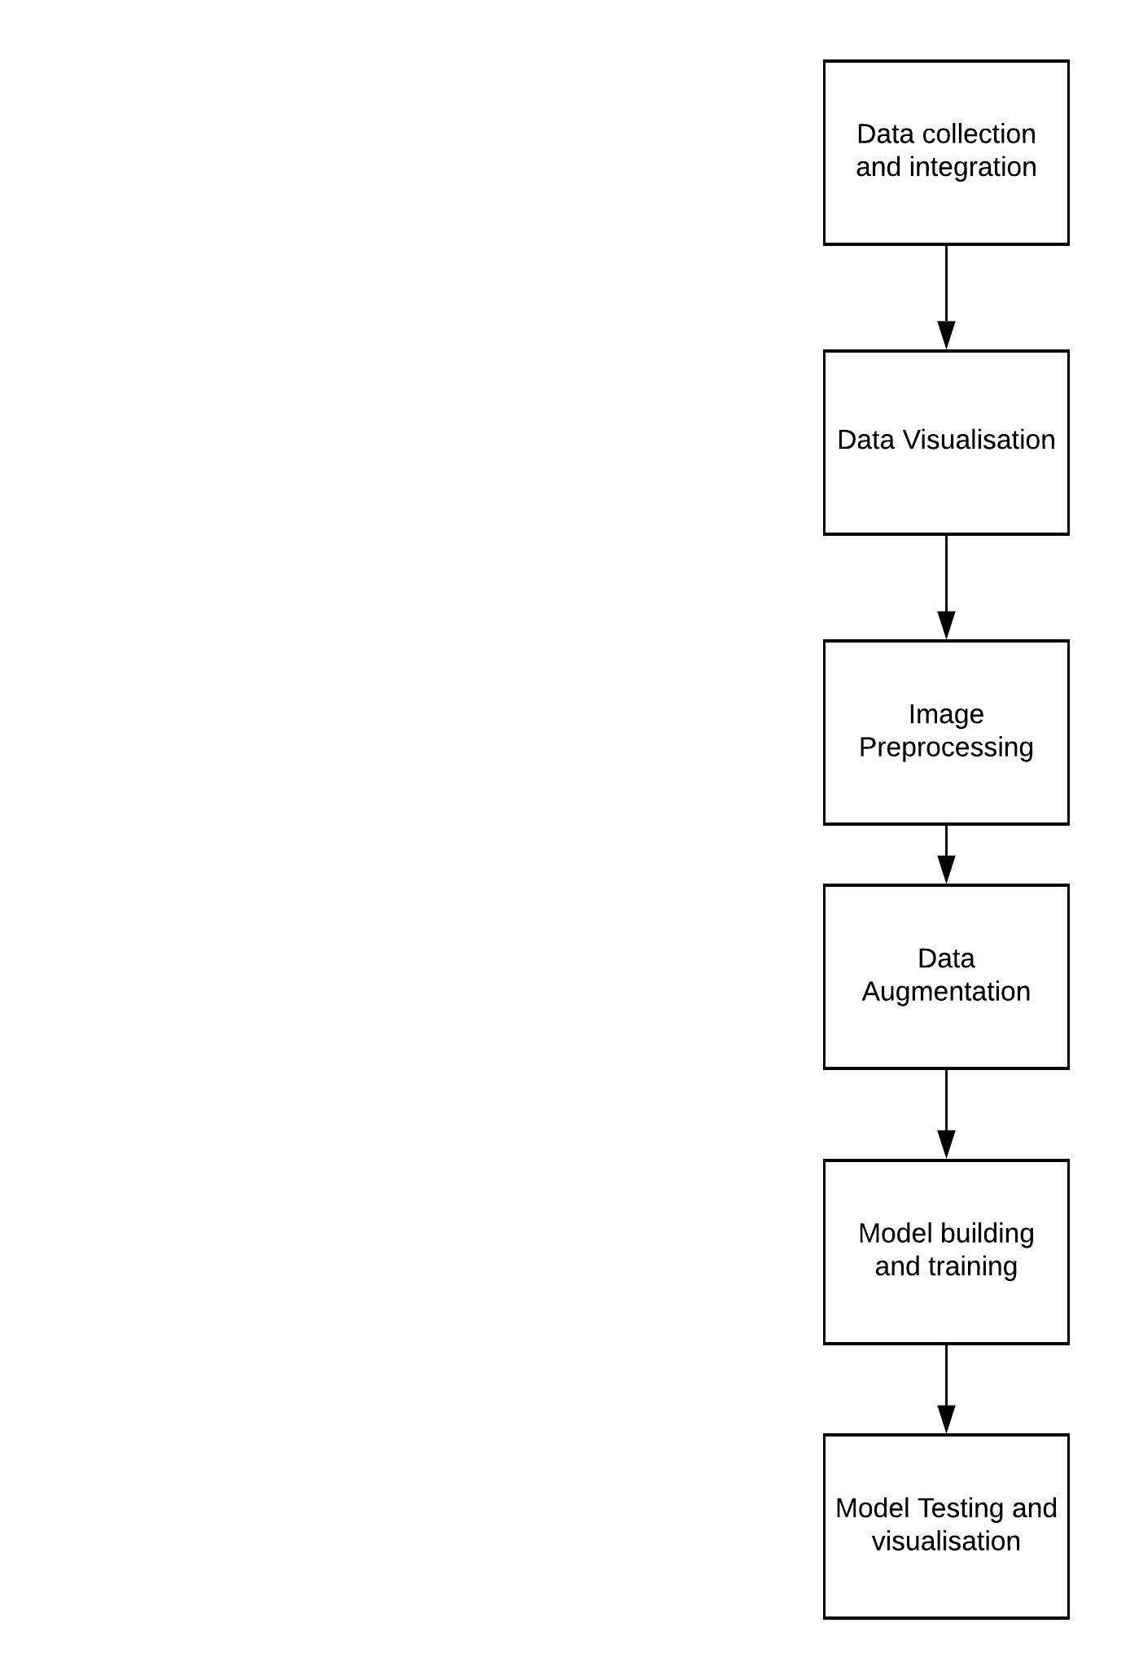
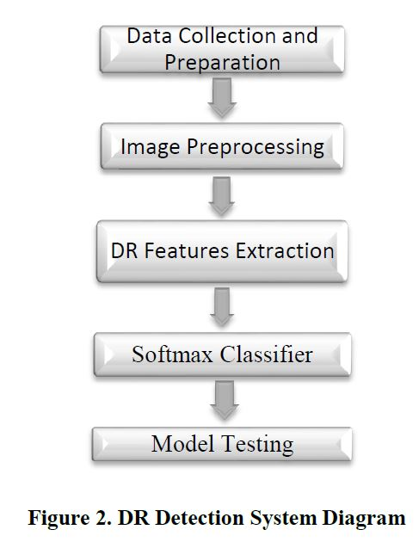
System Architecture
Figure 1:General Architecture

Slide 8
POSSIBLE METHODOLOGIES
1.USING CNN ARCHITECTURE:
one or more convolutional layers (often with subsampling step) and then followed by one or more fully connected layers as in a standard multilayer neural network. The architecture of a CNN is designed to take advantage of the 2D hierarchical structure of an input image
2.Using SVM classifier:An initial image processing stage isolates blood vessels, microaneurysms and hard exudates in order to extract features that can be used by a support vector machine (SVM) to figure out the retinopathy grade of each retinal image.
3.Transfer Learning:Transfer learning is the reuse of deep learning models that are pre-trained on huge datasets such as subsets of the ImageNet project to fit to a previously unseen dataset.

Slide 9
1.Layers in CNN or Pretrained CNN
Convolution : Many convolutions are carried out on an input, each using a special filter which leads to a typical feature map. All these stacks of feature maps are collected together resulting in the ultimate output of the convolution layer. The convolution layer comprises of a set of independent filters .Each filter is independently convolved with the image and we end up with 6 feature maps
Pooling : Its function is to progressively reduce the spatial size of the representation to reduce the amount of parameters and computation in the network. Pooling layer operates on each feature map independently.
Activation function:The purpose of the activation function is to set up non-linearity into the output of a neuron.
The FC is the fully connected layer of neurons at the end of CNN. Neurons in a fully connected layer have full connections to all activations in the previous layer, as seen in regular Neural Networks

Slide 10
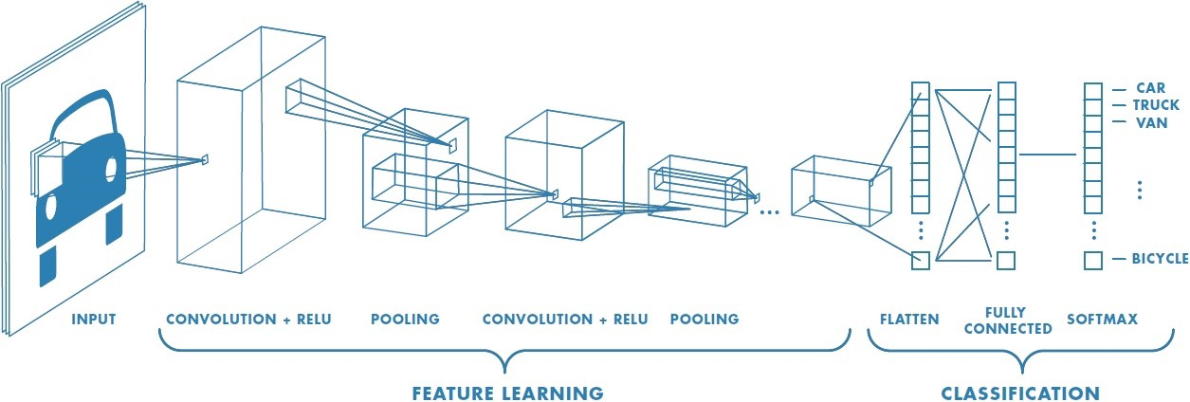
CNN EXAMPLE

Slide 11
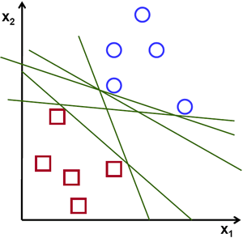
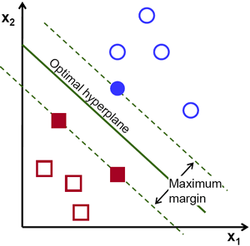
2.SVM Classifier
To separate the two classes of data points, there are many possible hyperplanes that could be chosen. Our objective is to find a plane that has the maximum margin, i.e the maximum distance between data points of both classes. Maximizing the margin distance provides some reinforcement so that future data points can be classified with more confidence.

Slide 12
3.Transfer Learning
Transfer learning refers to a technique for predictive modeling on a different but somehow similar problem that can then be reused partly or wholly to accelerate the training and improve the performance of a model on the problem of interest.
Train the entire model. In this case, you use the architecture of the pre-trained model and train it according to your dataset. You’re learning the model from scratch, so you’ll need a large dataset (and a lot of computational power)
Train some layers and leave the others frozen. Lower layers refer to general features (problem independent),while higher layers refer to specific features (problem dependent). if the dataset is large and the number of parameters is small, you can improve your model by training more layers to the new task since overfitting is not an issue.
Freeze the convolutional base. This case corresponds to an extreme situation of the train/freeze trade-off. The main idea is to keep the convolutional base in its original form and then use its outputs to feed the classifier. You’re using the pre-trained model as a fixed feature extraction mechanism, which can be useful if you’re short on computational power, your dataset is small, and/or pre-trained model solves a problem very similar to the one you want to solve.

Slide 13
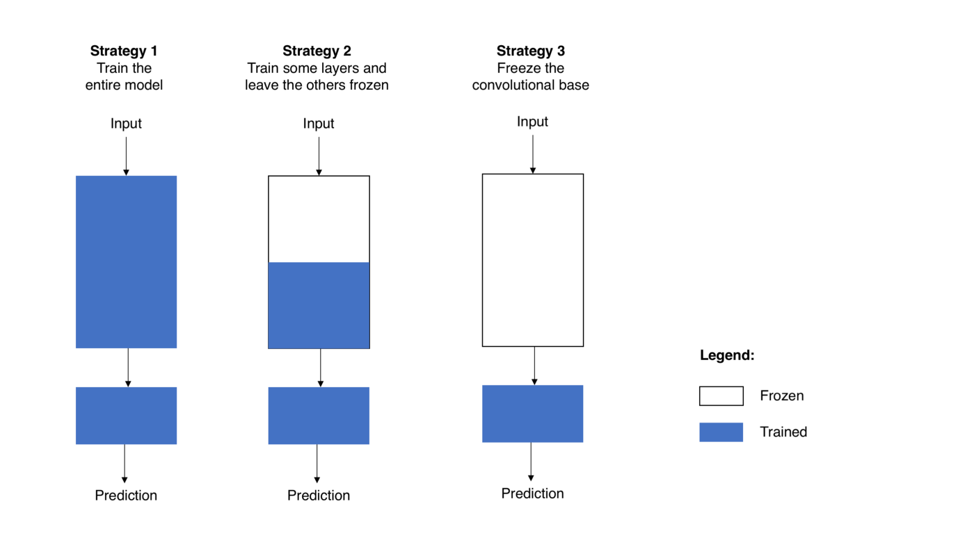

Slide 14
SPECIFIC REQUIREMENTS
Hardware Requirements:
4/8GB RAM
Processor -intel core i3
GPU/CPU
Software Requirements:
Google Colab or
Jupyter Notebook or
Kaggle Notebook

Slide 15
Python Libraries used :
Keras –Neural Network Library:
Keras is a licensed version of Neural Network library. It was written using Python that runs on pinnacle of Tensor flow. Keras is sketched to be efficient, fast, less bugs, less stress and cost effective to use moreover modular. Comparing the computation level of Keras, it focuses on high level of computation.
Tensorflow:
Tensor Flow is the most well known deep learning library in these current advancements. This library has been developed by Google Brain Team for enhancing the computing device of both accuracy and time using ML and DL algorithms.

Slide 16
DATASET:
provided with a large set of high-resolution retina images taken under a variety of imaging conditions.
1.From Kaggle competition conducted in the year 2019.
2.APTOS Blindness detection Challenge dataset:
First database representative of an Indian population
dataset is divided into two parts: A.Train images B.Test images
3662 Train images and 1928 test images

Slide 17
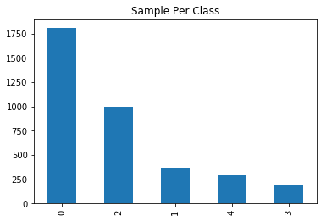
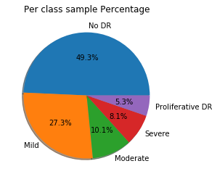
Dataset Graphs:

Slide 18
FEASIBILITY STUDY
AUTOMATED DETECTION AND GRADING OF DIABETIC RETINOPATHY is economically feasible as its time efficient and does not require much resources .
The algorithms can be inbuilt into any computer device or by internet connection accessing via API of it for the retinal image to be classified as DR or Non-DR
Can be used in eye hospitals for surety of decision to be made regarding the treatment for the patient and treated on the severity of the disease.

Slide 19
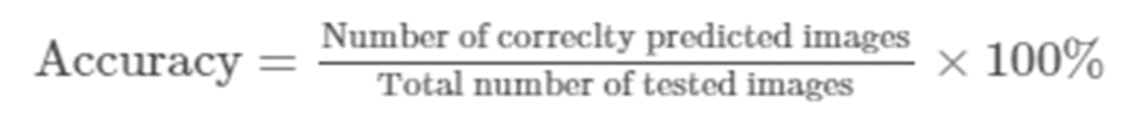
EXPECTED OUTPUT
important to measure the number of correctly and incorrectly classified test images,but also to evaluate by how many classes the images were misclassified and to penalize the accuracy score accordingly
Classifying the input image is rightly classified or not using performance metrics like sensitivity,specificity and accuracy.
We will be using accuracy as a metric to justify the model performance which can be defined as:

Slide 20
STEPS IN BUILDING THE DIFFERENT MODELS

Slide 21
I.Image Pre-processing
Crop out black areas from background and lighten the images-Ben’s preprocessing technique
Read Image
Apply masks
Resize image to (224,224) size
Apply Gaussian noise to increase Robustness

Slide 22
II. Data Augmentation
Image data augmentation is perhaps the most well-known type of data augmentation and involves creating transformed versions of images in the training dataset that belong to the same class as the original image.
Transforms include a range of operations from the field of image manipulation, such as shifts, flips, zooms, and much more.
In one of the models we trained we increased each classification type to around 5000 images each

Slide 23
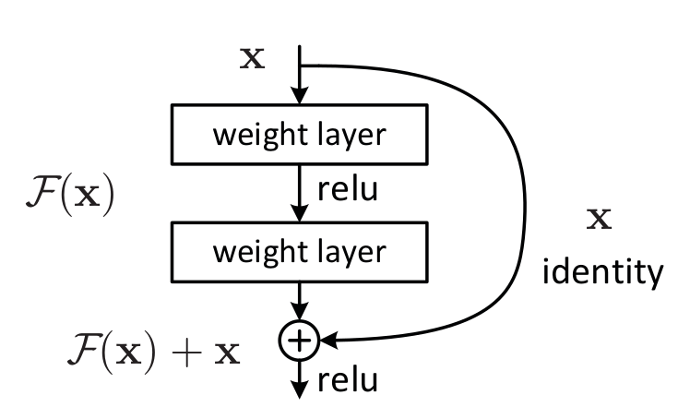
III. MODEL TRAINING AND TESTING
Two pretrained models used here:
RESNET50 Model:
ResNet50 is a variant of ResNet model which has 48 Convolution layers along with 1 MaxPool and 1 Average Pool layer.
The authors addressed the problem of vanishing gradients which makes DNN to converge and accuracy gets saturated by adding of additional layers so by introducing deep residual learning framework so for this they introduce shortcut connections that simply perform identity mappings

Slide 24
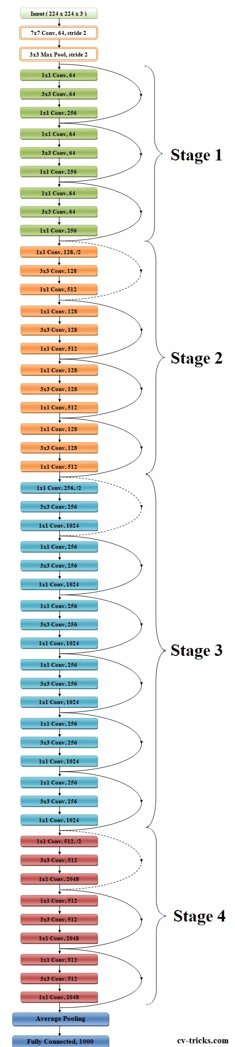

Slide 25
2. XCEPTION Pretrained model
the Xception (Extreme Inception)architecture is a linear stack of depthwise separable convolution layers with residual connections.
The 36 convolutional layers are structured into 14 modules, all of which have linear residual connections around them, except for the first and last modules.
the original depthwise separable convolutions as usually implemented (e.g. in TensorFlow) perform first channel-wise spatial convolution and then perform 1×1 convolution whereas the modified depthwise separable convolution perform 1×1 convolution first then channel-wise spatial convolution.

Slide 26
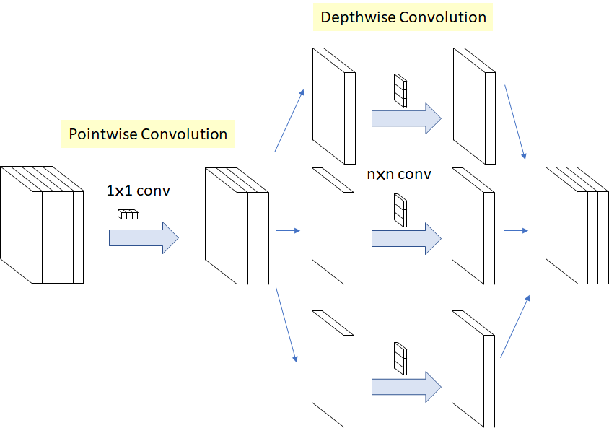
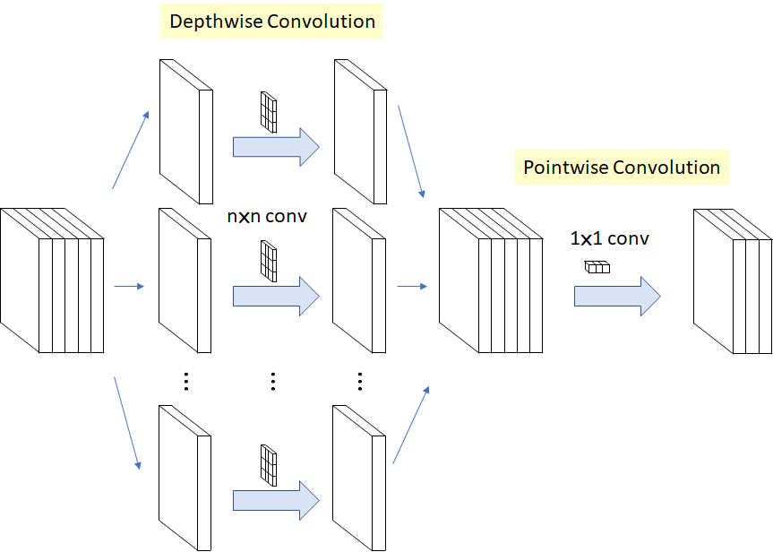
Original Inception architecture
Xception Architecture

Slide 27
Model 1: Resnet50 with relu and adam optimizer
For the model the Resnet50architecture’s layers were considered as base model then the final few layers were modified.
2048 dense hidden layers were added with relu as activation function and 50% of dropout after which output layer with 5 class labels was specified along with softmax as activation function.
The model was compiled using Adam optimizer and categorical_crossentropy loss and accuracy as the evaluation metric. The model ran for 8 epochs.

Slide 28
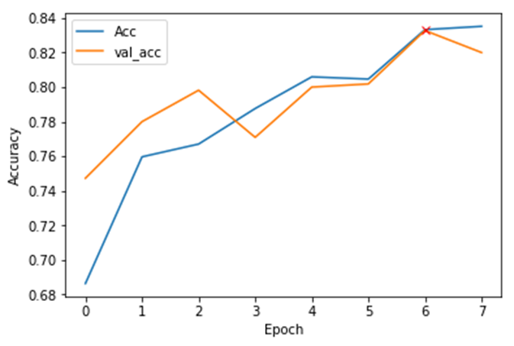
Model 1 gets 82% validation accuracy

Slide 29
MODEL 2:RESNET50 with LeakyRelu and SGD optimizer
The model is trained on top of Resnet50 pretrained model and adding dense inner layers with ‘LeakyRelu’ activation function and variant dropout rates after each batch normalization to output 5 number of classes prediction label.
The model is compiled using stochastic gradient descent optimizer and loss function to be the categorical cross_entropy with accuracy as metric which was fit for 15 epochs.
The model received an validation accuracy of 79% where I used ‘relu’ as activation function and another gave me 80.82% accuracy as seen in the graph below .

Slide 30
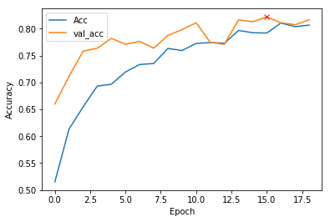
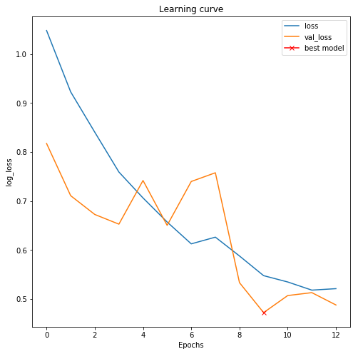
Accuracy graph:

Slide 31
Model 3: Resnet50 with no preprocessing
The model is trained on top of Resnet50 pretrained model and adding dense inner layers with ‘relu’ activation function and variant dropout rates after each batch normalization to output 5 number of classes prediction label.
The model is compiled using adam optimizer and loss function to be the categorical cross_entropy with accuracy as metric which was fit for 20 epochs.
The model received an validation accuracy of 71% and testing f1-score to be 0.70 seen in the table below .

Slide 32
Model 3 Classification Report
Classes Precision Recall F1-Score Support
0 0.85 0.99 0.91 144
1 0.00 0.00 0.00 40
2 0.50 0.89 0.64 70
3 0.00 0.00 0.25 18
4 0.02 0.39 0.31 23
Accuracy 0.70 294
Macro Avg 0.27 0.38 0.31 294
Weighted Avg 0.53 0.70 0.83 551

Slide 33
MODEL 4: XCEPTION ARCHITECTURE
For the model the Xception architecture’s layers were considered as base model then the final few layers were modified.
512 dense hidden layers were added with relu as activation function and 30% of dropout and again 18 dense hidden layers after which output layer with 5 class labels was specified along with softmax as activation function.
The model was compiled using Adam optimizer and categorical_crossentropy loss and accuracy as the evaluation metric. The model ran for 30 epochs each of 20 steps.

Slide 34
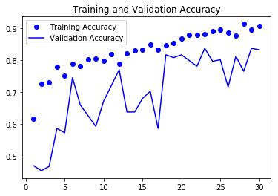
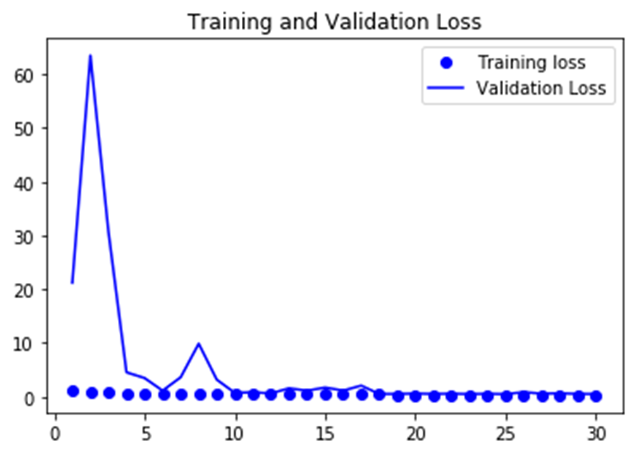
Model 4 gives 83%validation accuracy

Slide 35
Results and Analysis
Sr no Model used Validation accuracy Validation Testing accuracy(%)
(%) loss
1. Resnet50 and relu activation 81 0.52 52
2. Resnet50 with leakyrelu activation 80 1.3028 20
3. Resnet50 with no preprocessing 71 0.98 60
4. Xception with preprocessing 83 0.512 73
As we can see the Xception architecture with preprocessing has helped gain better performance for these retinal images.

Slide 36
CONCLUSION
The study described a blindness detection method designed using two pretrained models that analyses retinal images to determine the label of blindness.
we compared different pretrained models mainly Resnet50 and Xception, based on different optimizers and activation function for DR level severity classification.
The preprocessing and augmentation helped us achieve better accuracy especially in Xception architecture. However, the performance of model in identifying some classes is still far less then optimum, which leaves a vast scope to work with it in the future.

Slide 37
FUTURE SCOPE:
In addition to tackle highly imbalanced classes in the dataset, proper augmentation of least classified images is required. The deep learning technique gives significant improvement only when good preprocessing is done like applying masks, resizing the image to fixed size so that it makes it easy to train.
Other pre-trained deep convolutional networks should be used for experimenting and comparing performances in DR classification using small training data.
Also remodifying some of its last few layers with correct normalization and dropout hyperparameters to give us the perfect diagnosis classification closest to the actual values.

Slide 38
References:
1.Diabetic Retinopathy Detection using Deep Convolutional Neural Networks Darshit DoshiSardar Patel Institute of Technologydarshit.doshi@gmail.comAniket She􀁑oySardar Patel Institute of Technologyshenoyaniket95@gmail.com
2.Automated detection of diabetic retinopathyusing SVM Enrique V. Carrera Dept. de El´ectrica y Electr´onica Univ. de las Fuerzas Armadas ESPE Sangolqu´ı, Ecuador evcarrera@espe.edu.ec Andr´es Gonz´alez Dept. de El´ectrica y Electr´onica Univ. de las Fuerzas Armadas ESPE Sangolqu´ı, Ecuador spedygon007@gmail.com
3. Recognition of Diabetic Retinopathy Basedon Transfer Learning Yuchen Wu,Southwest Petroleum University,Chengdu, China,e-mail: yuchenwu369@163.co

Slide 39
THANK YOU!

